Slide 1
PulpWeave
Monetized Open Cloud Development
Redefining Intellectual Capital

Slide 2
PulpWeave

Slide 3
PulpWeave
This Presentation will be divided into three sections:
Section 1: Intellectual Capital
Section 2: Business Traction Led Development
Section 3: Monetization of Intellectual Capital

Slide 4
PulpWeave: IK
Monetized Open Cloud Development: an intellectual capital digital domain to redefine intellectual pseudo property into a frictionless many to many domain with the object of network effect formation of monetized intellectual capital clusters.
By allowing objects to be market determined, evolution from entrepreneurial traction seeking events to business process definitions to enterprise grade fixed systems is assured. Instead of making fixed systems, who’s brief is obsoleted before it is brought to market, a capital market for knowledge clusters raises the prototyping paradigm center stage.
Once a prototype can be proven in a market determined commercial activity, a business case can be made. And only once it has achieved true enterprise volume, can an enterprise grade solution be specified.
This of course rests on the ability to produce commoditized knowledge clusters, commoditized code, of differing complexity, cost and ease of deployment, so as to take entrepreneurial activity to its logical end: business traction.

Slide 5
PulpWeave: IK
The first question to ask is what is the problem to be solved. The itch is the failure of the current arsenal of intellectual property tools to address the digital age generally, software code specifically, and to allow for profits to cover for the risk premium that technological innovation requires.
That can only be solved by understanding how the current system protects intellectual goods, and what are the consequences of those choices.
Clearly a new paradigm must be introduced to the market to overcome the limitations of the current system. The only way that innovation can occur is if financial compensation is there for market relevant knowledge clusters.
Commoditizing code so that it can be transacted freely can only occur if a new contract structure is adopted: the Pulpweave Intellectual Capital Market.
First lets look at how property right are determined:

Slide 6
PulpWeave: IK

Slide 7
PulpWeave: IK
Defining the Problem:
Patents protect an industrial or business process, not, ideas or code.
Copyrights protect verbal expression, and are literary legal constructs.
They are predicated on original ideas, expression, attitudes against monopoly power and the preservation of the commons. Where it is stated that in order to avoid monopoly, which will damage the commons, the law will avoid protecting the creation of new ideas, and only protect the expression thereof.
Code is not poetry, it is business, and PulpWeave is in the business of CODE MONETIZATION through the creation of a new legal paradigm that allows for code clusters to be freely traded, at a known cost that is market determined.

Slide 8
PulpWeave: IK
What Pulpweave proposes is to grant protection to original ideas extended to include process, principle, application, hierarchy, structure, standards and visual representations of actionable commands.
In short: Grant protection to original ideas and expression provided that monopoly is limited strictly to the determination of economic incentive necessary for the innovator to profitably contribute.
White patents are purposefully limited in scope to the process at hand, Pulpweave IK will purposefully be wide in scope so as to allow for re-use, adaptation and incorporation.

Slide 9
PulpWeave: IK
The Digital Millennial Copyright Act makes decompilation illegal: there is no addition to the art, for a closed system does not invite further innovation. Copyright presupposes expression, not ideas or code expression.
The America Invents Act, ties all software to process, namely business process. Software code is not protected, only the business process using it.
That ties innovation to existing capital formations that dominate the revenue streams.
AIA thus seeks to limit an idea to a single business process precluding the commoditization of the underlying technology. Not having a property right means not being able to commercialize the rights to innovation.

Slide 10
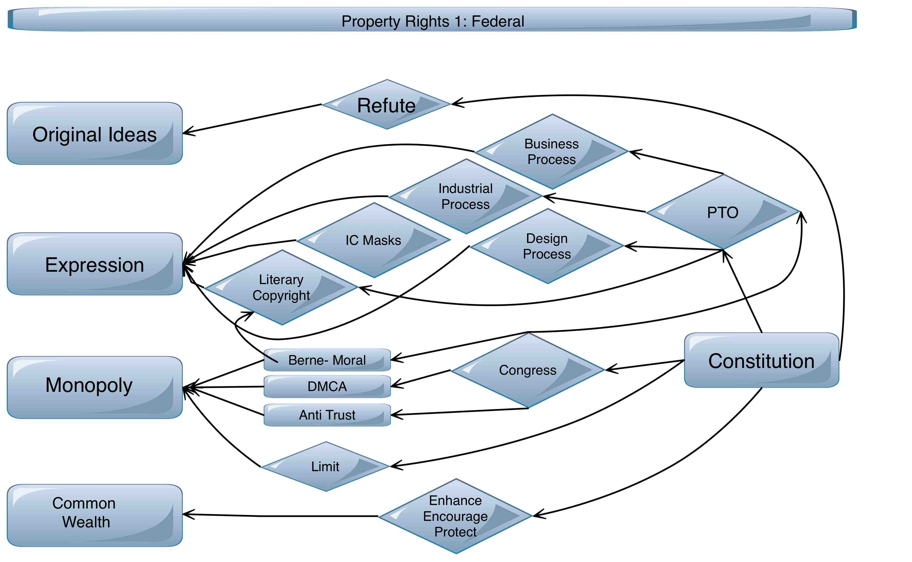
PulpWeave: IK
The constitutional, federal, provisions for granting monopoly to new additions to the art.

Slide 11
PulpWeave: IK
State Rights: Private Contracts: “Intellectual Property”
IP is an end run around patent and copyright:
IP is predicated on the ability to contractually enforce Trade Secret Provisions through a technology license, under State Law.
What is not known cannot be improved upon.
The end run was married to the literary concept of Moral Rights (Berne Convention) where the “author” has complete control over the use of his creation.
This de facto precludes the re-use of code, and stymies down stream innovation.
It denies the monetization of code in alternative industries or applications.
Novel code cannot be created outside of competing ecosystems.

Slide 12
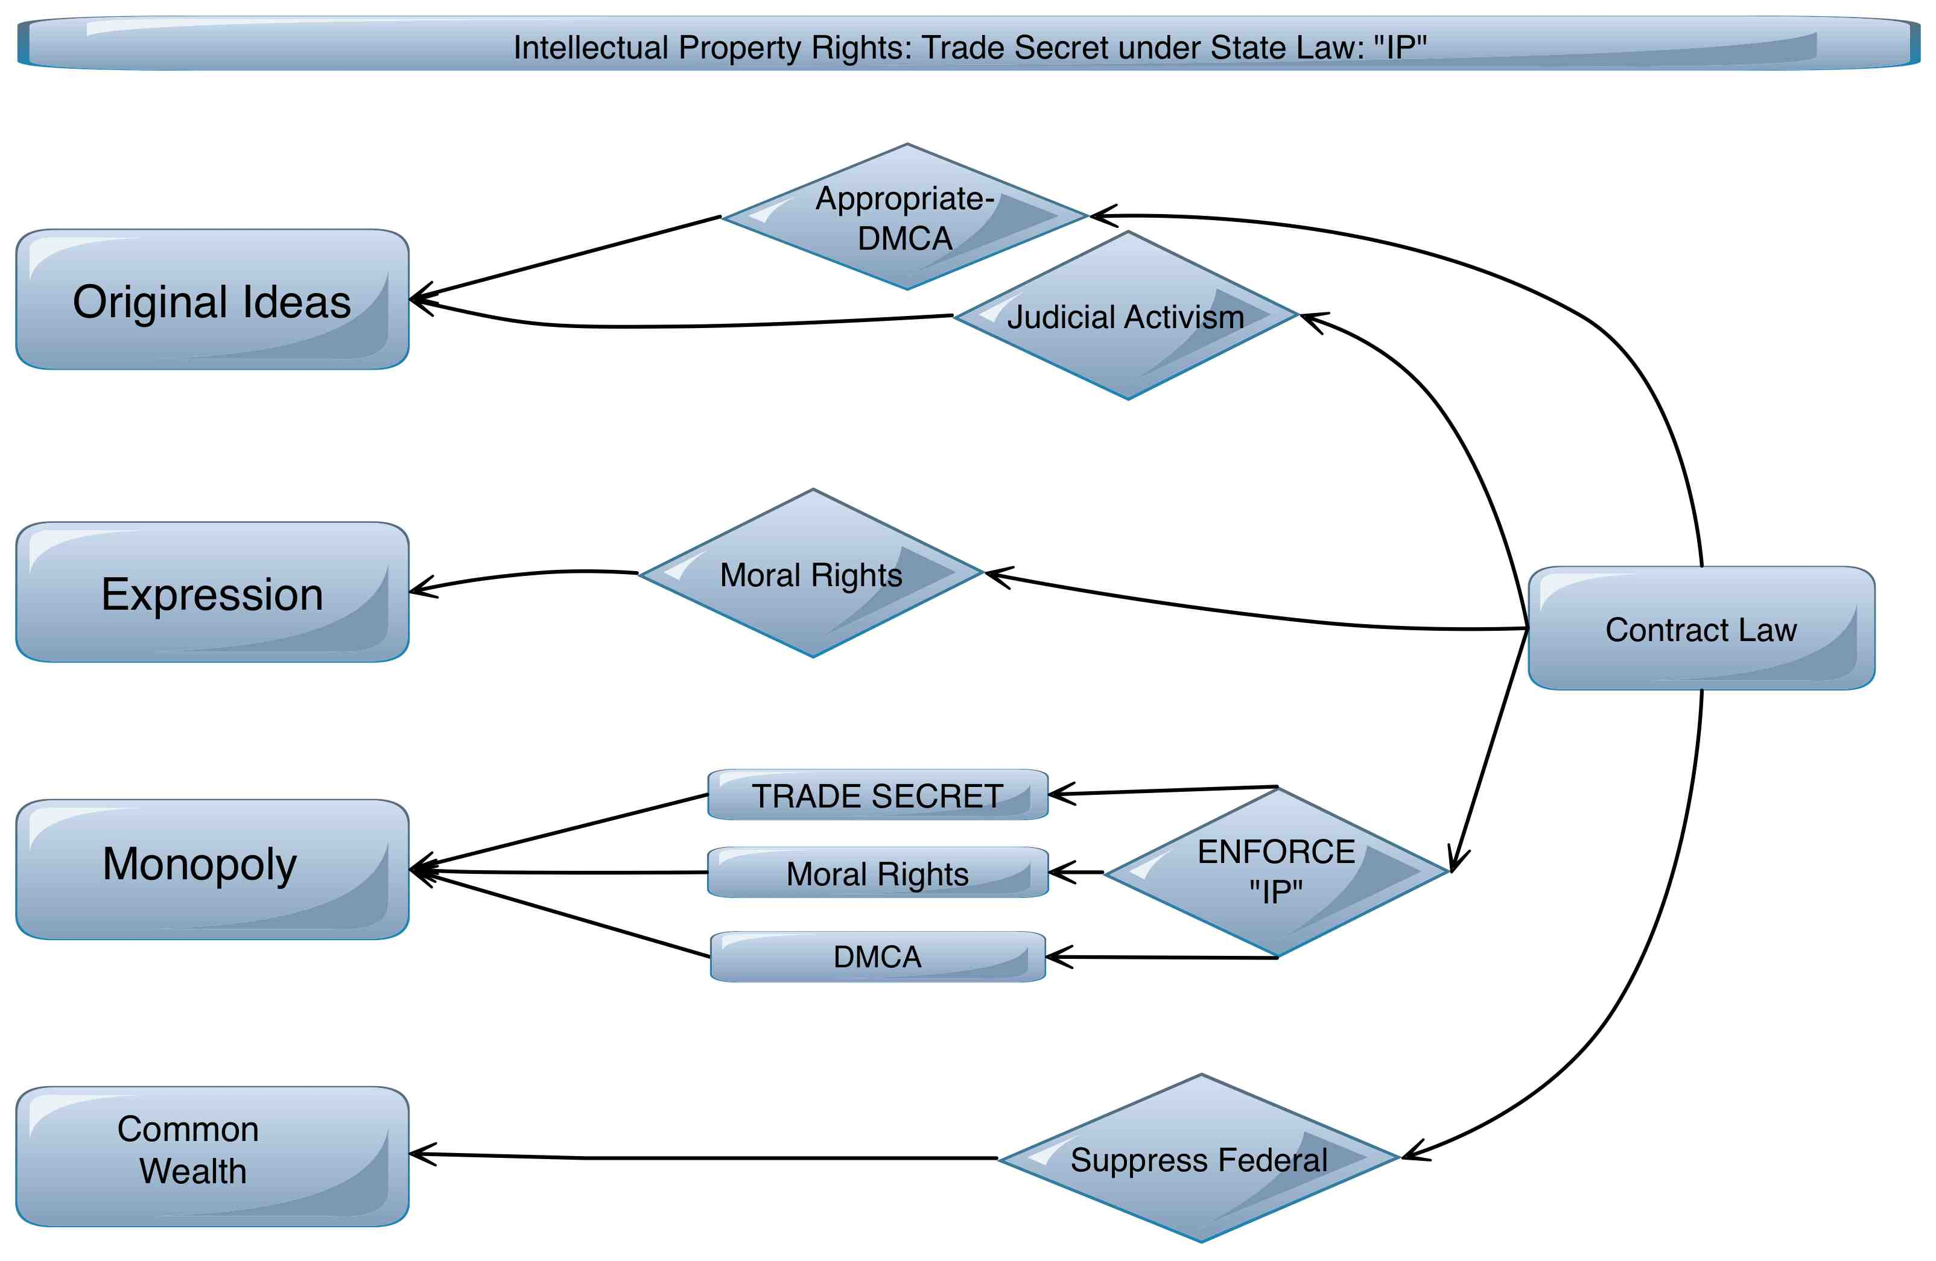
PulpWeave: IK

Slide 13
PulpWeave: IK
The General Public License is a response to the need for specialized technical knowledge without having to re-invent the wheel every time.
The problem is that Open Source initiatives defy rational action by denying the profit motive. This the economic premise of GPL is flawed.
Provided that the collaborative, incremental knowledge and contribution to Cloud Computing is predicated on the absence of commoditized knowledge clusters, the model is bound to fail.
GPL rests solely on the ability to generate revenue for installation and support, and for carrying the warranty liabilities.
Furthermore the only economic benefit is to established revenue models that can appropriate the value and generate process and business patents. Thus the established players free ride on the innovations of others, and exclude further innovation by using patents as restraint of trade.

Slide 14
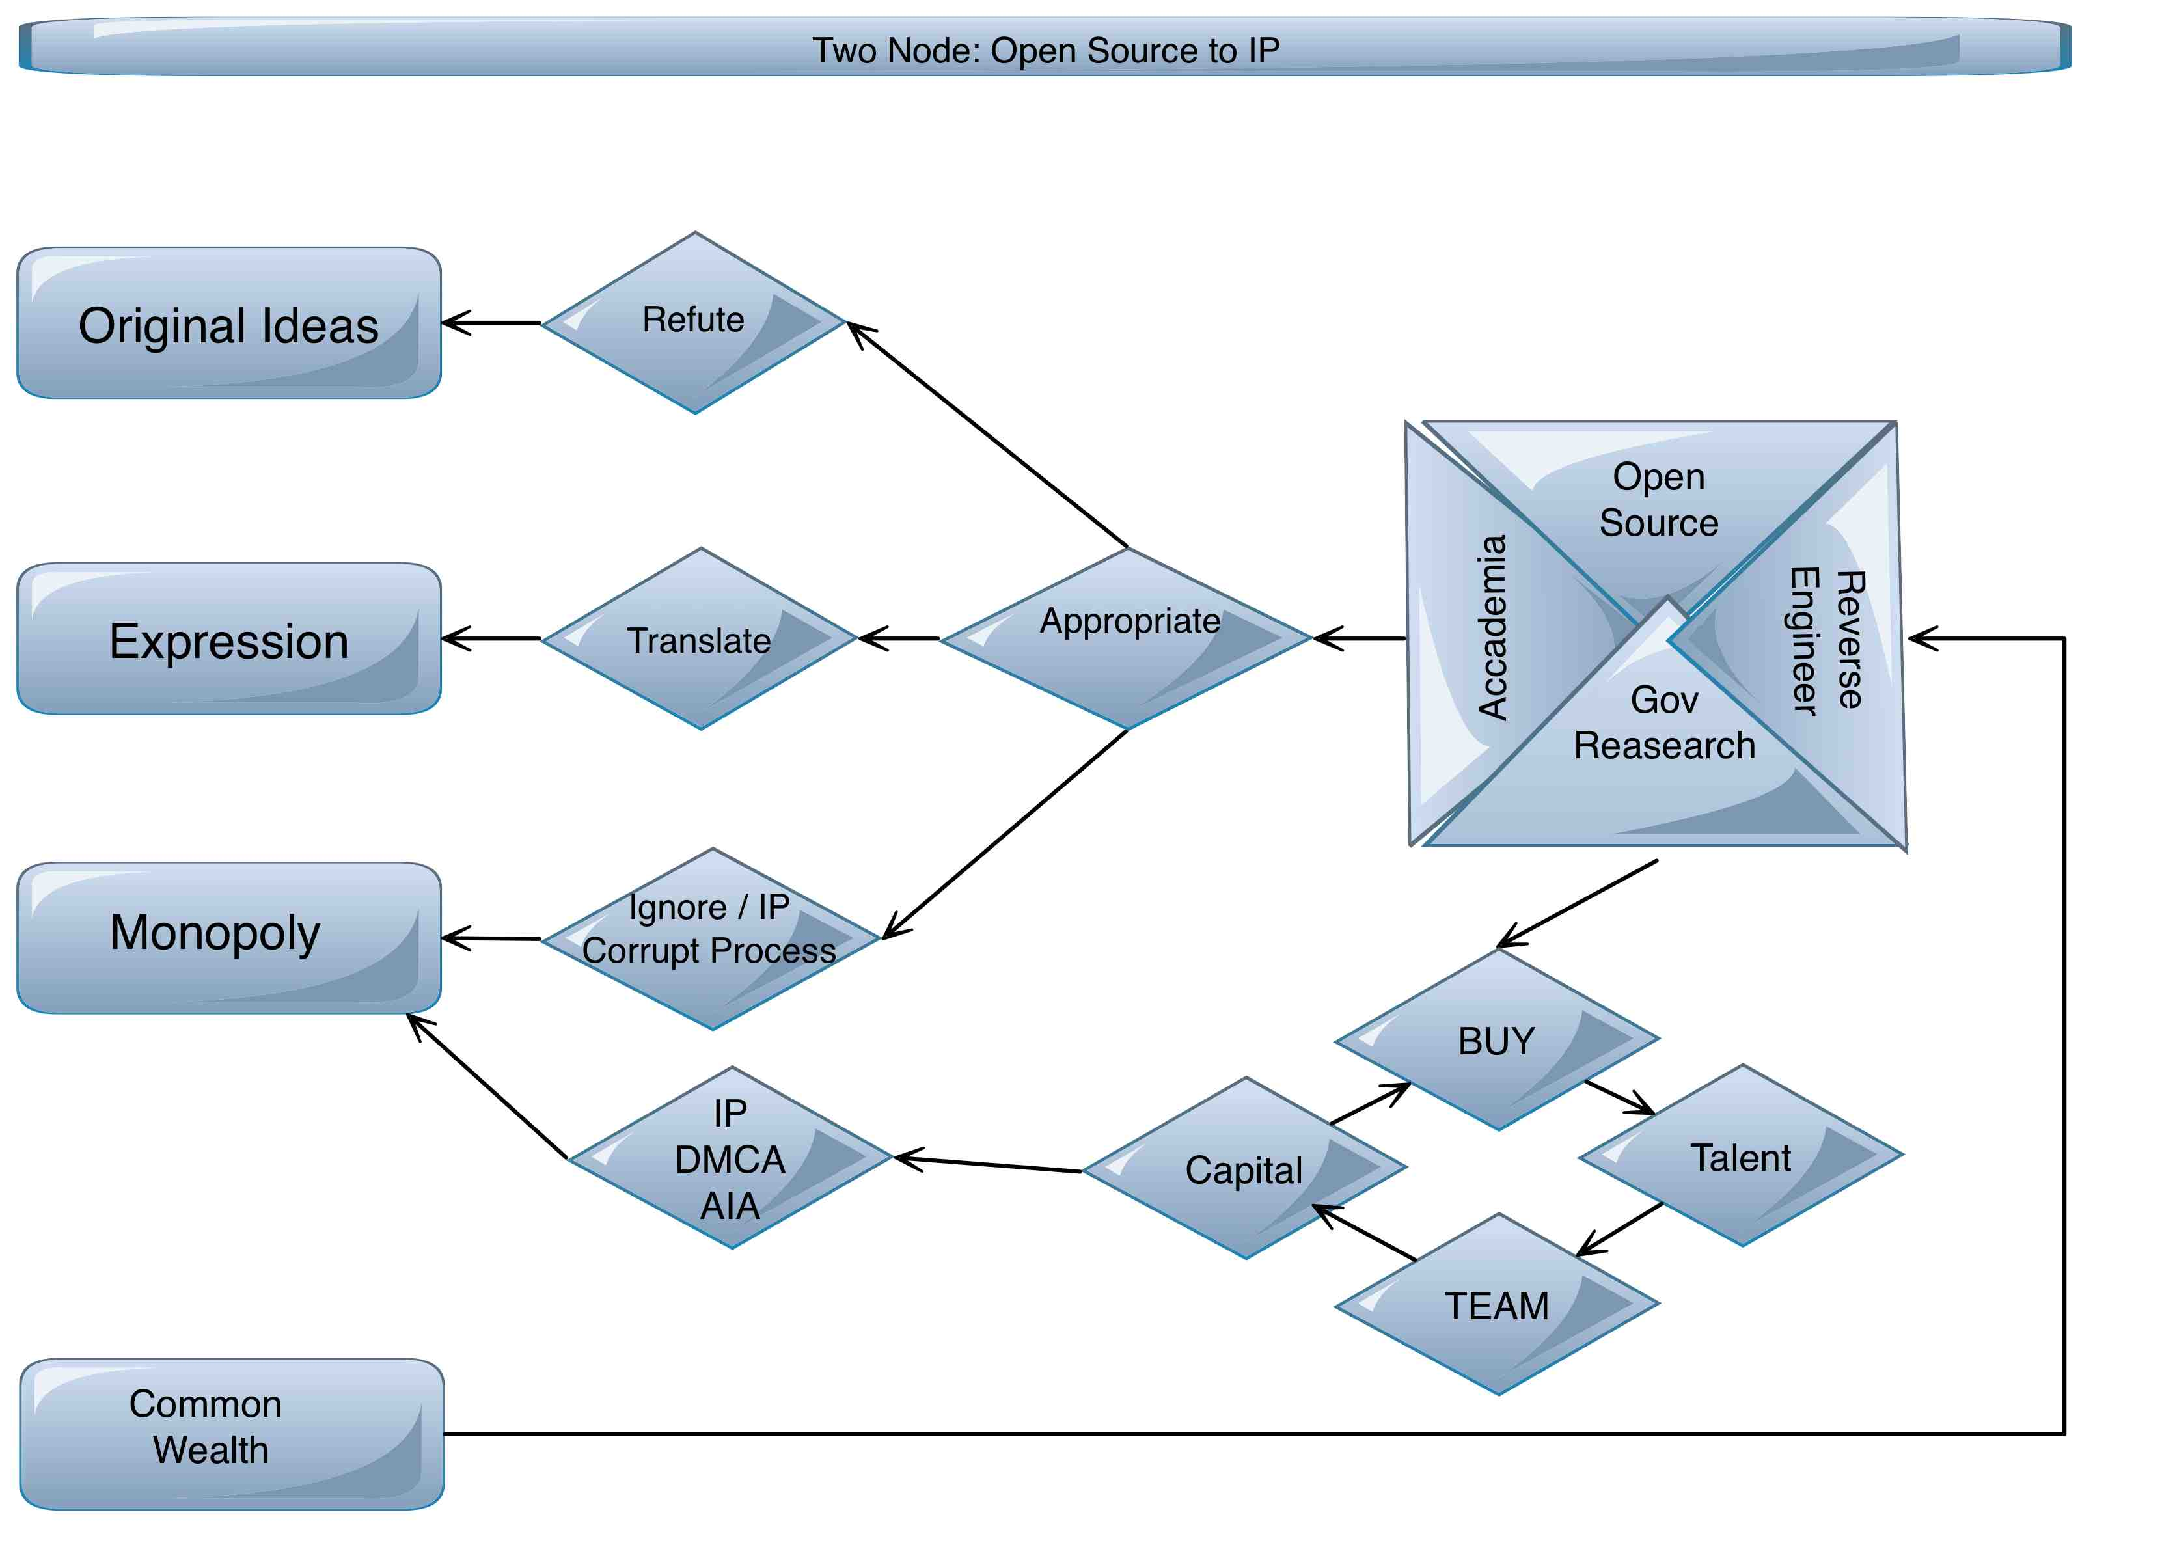
PulpWeave: IK

Slide 15
PulpWeave: IK
What PulpWeave proposes is to grant protection to original ideas extended to include process, principle, application, hierarchy, structure and visual representations of actionable commands.
In short: Grant protections to original ideas provided that monopoly is limited strictly
To the determination of economic incentive necessary for the innovator to profitably contribute or attract the investment necessary to do so.
Pulpweave is a private contract for the aggregation of code clusters, its distribution, and for the financial compensation of innovators and marketers. Thus its an Intellectual Capital Domain that does away with free riding and restraints of trade.
PulpWeave’s basic premise is that within the contractual domain a contributor is free to modify any code, cluster, bill of materials or distribution to his liking provided the upstream contributors are automatically compensated. This is achievable by being the distributor and infrastructure provider.
The consumer/contributor only controls the price of his innovation. It is thus free of power pays and one to one negotiation. It is many to many distribution with automatic rights management.

Slide 16
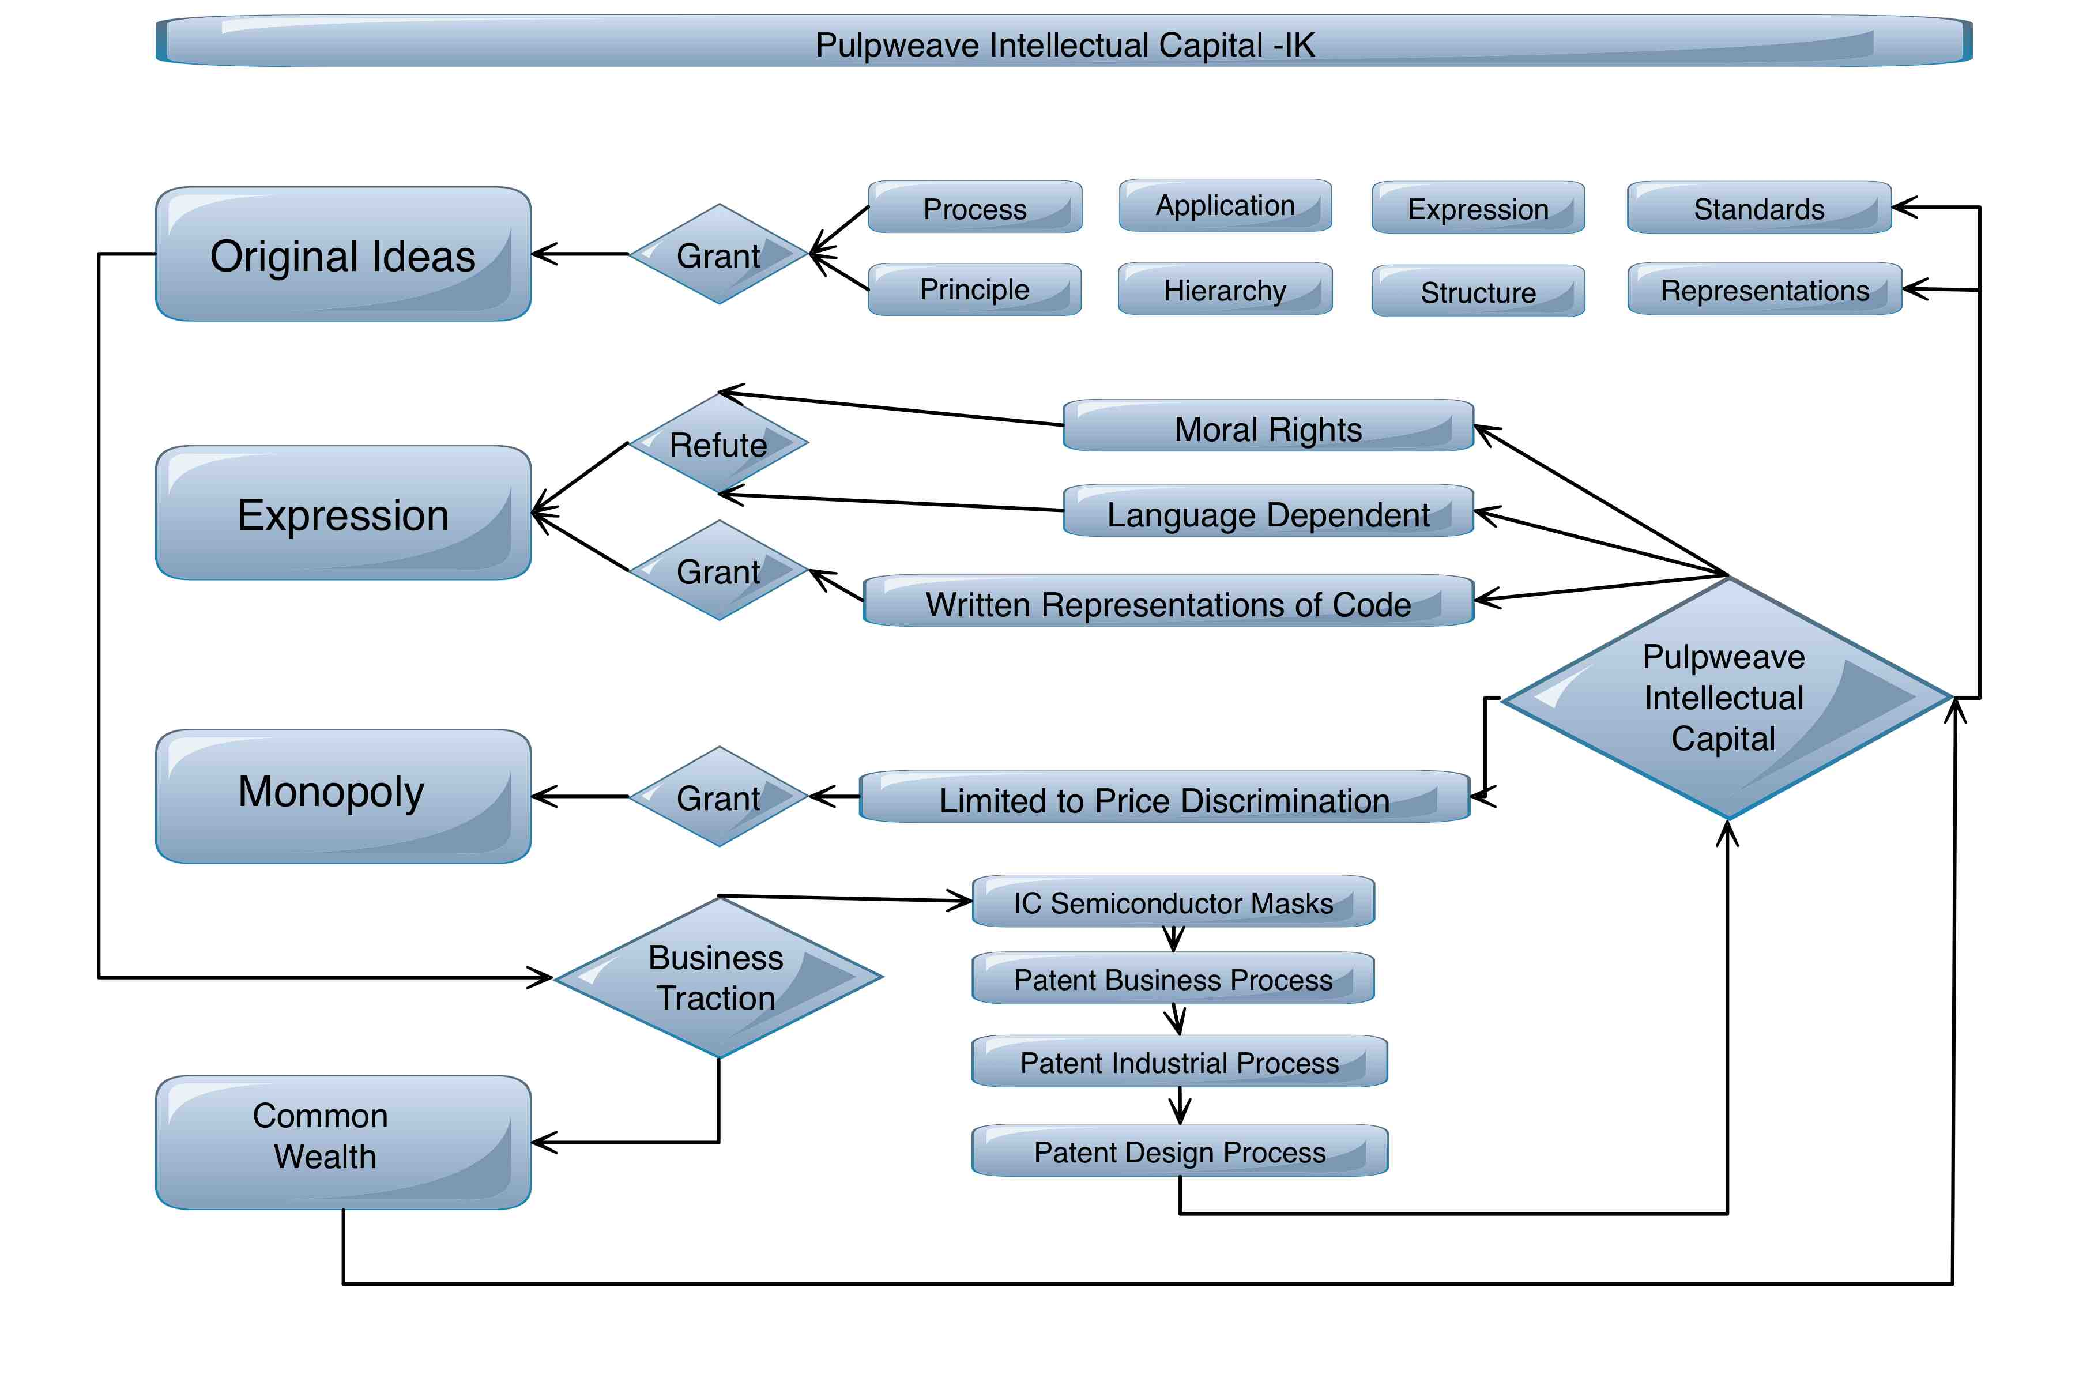
PulpWeave: IK

Slide 17
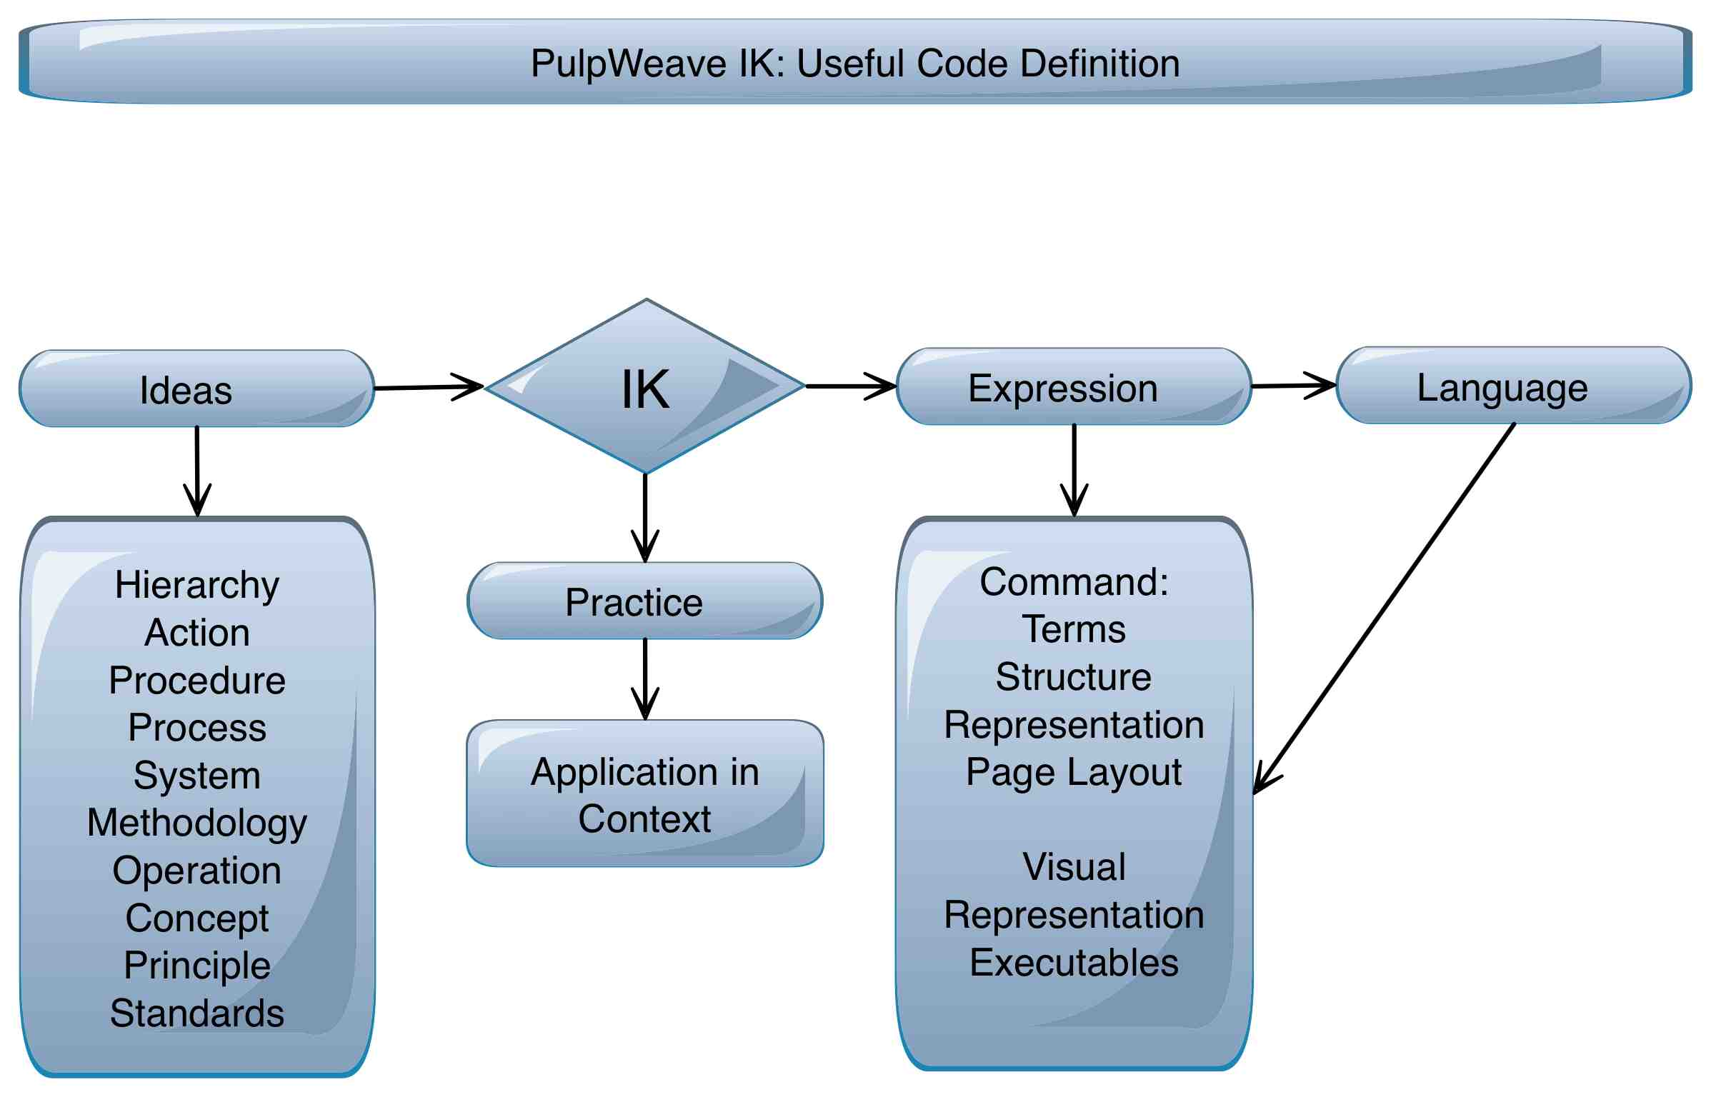
PulpWeave: IK

Slide 18
PulpWeave: IK
In the PulpWeave paradigm the distribution occurs when the final value gets consumed or repurposed. Consequently in the market for digital goods, specifically commoditized building blocks of code, one fulfills one’s bill of materials after the goods are transacted.
Acting as the distributor allows PulpWeave to receive payment from the end user, and concurrently pay the contributors that supply the digital goods to the seller.
In the digital domain the cost of goods sold is posted post invoice, absent is the pro forma.
Short: A structured rule based system within a privately contracted legal domain under contract law, with a legal resolution process based on known rules, established procedures, and an established payment process.

Slide 19
PulpWeave: IK
Pulpweave will operate under the following principles:
Elimination of Moral Rights
Elimination of 1:1 negotiations
Elimination of Trade Secrets
Elimination of transactional costs
Contributor controls price alone
Contributors have the right to aggregate, modify and create
Cumulative technology growth is fully distributed
Commoditization of code, software blocks, code structures and libraries
Re-use and re-engineering of distributions in any industry
Known application programming interfaces are granted internal trademark
Translation is a executable competitive function
Peer review (de-bugging) of known contributions are monetizeable
IK, IP, Patents or Open Source can be monetized
Price stability is built into contract structure

Slide 20
PulpWeave: IK
PART TWO: IK : BUSINESS TRACTION LED DEVCELOPEMENT
Property Rights foster economic coordination.
Knowledge capital encapsulation fosters integration of specialized knowledge
Commoditization supports a clear division of knowledge
Commoditized Boms disintermediate evolving complexity into meaningful chunks
By allowing objects to be market determined, evolution is traction determined.
Instead of making fixed systems, who brief is obsoleted before it is brought to market, a capital market for knowledge raises the prototyping paradigm center stage.
Once a prototype can be proven in a market determined commercial activity, a business case can be made. Only once a business case can be made on verifiable facts and figures can an enterprise grade solution be specified.
Regardless of business activity, traction should be sought with commoditized tools. Entrepreneurship should be business transacted based on known code clusters, investment only following a business case being proven.
Each stage of business growth should have its own tools and processes.

Slide 21
PulpWeave: IK

Slide 22
PulpWeave: IK
The fundamental benefit of a code based contractual domain is the intersection between advanced business engineering and the specialized technical knowledge necessary to make it happen.
Pulpweave is a contractual distribution that allows business and entrepreneurship to find the specialized knowledge necessary for advanced processes. It allows business re-engineering without having to re-invent the wheel at every evolution.
Pulpweave allows technically specialized knowledge to pursue their craft without being burdened with non technical activities.
Pulpweave allows the financial engineer to distribute its sunk costs (IK + Team) beyond the immediate investment, industry or geographic area.

Slide 23
PulpWeave: IK
Commercial maturity determined the choice of tools, processes and business needs.

Slide 24
PulpWeave: IK
PulpWeave is a distribution channel for all existing code assets.
PW is a known and legally efficient rule based system for the monetization of code/software clusters
Revenue Streams
Network centric innovation
Code submittal
Code Review
Code distribution
Allocation of legal protections
Dispute resolution
Infrastructure deliverables
Sophisticated consumer contracts
Commoditized business processes
Revenue Streams
Publishing
Arbitration and dispute resolution
End user licensing
License Administration
Business Intelligence
PTO filings
The code is already out there, it simply needs to be profitably brought to market under known rules, in a financially and legally efficient manner.

Slide 25
PulpWeave: IK

Slide 26
PulpWeave: IK
Pulpweave seeks to tear apart the divide between producer and consumer.
In the modern digital age, consumption requires the extrapolation of value and its re-creation into new value. To consume is to create.
Anybody who can transform form or function is a contributor, a sophisticated innovator. Repurposing is consumption the moment that value add is passed along the value add chain.
A sophisticated consumer is subject to the rules and regulations of joining Pulpweave
Consumers, where a “sale” occurs, are instead subject to consumer laws:

Slide 27
PulpWeave: IK

Slide 28
PulpWeave: IK
PART THREE: IK : BUSINESS TRACTION LED DEVCELOPEMENT
Creating Knowledge Clusters and Monetization
From abstract classification we can draw definitions, as software and hardware can be construed as having:
A main purpose
A structure as represented by a flow chart
Modularity of program operations
And/or types of storage & their interrelations
Individual algorithms, parameter lists, macros, data structures
Source code used for individual operations or data structures
Object code
Methods for input and output of data
Representations
Both Idea and expression are capable of being treated as separate when one is seeking to match economic incentive with creation.

Slide 29
PulpWeave: IK
The biggest problem faced when trying to innovate is the extensive lock in around older technologies.
There are only so many iterations that can be devised to tap into the existing 8088 processor family. And most of those have already been appropriated by legacy players.
The artificial construct around software and the artificial construct around hardware must be bridged so as to allow true efficiency and innovation to occur.
Regardless, any new addition to the art, in the current lock in environment requires building on top of unknown layers protected by IP (trade secret under State Law), Process Patents and the long list of Mask Protections for the hardware stack.
We will address the software stack first, then the hardware stack, and then show how they can be overcome to liberate innovation in an investment secure digital rights domain.

Slide 30
PulpWeave: IK
Currently building out new constructs requires building on top of a high stack of proprietary constructs.
Namely the legacy operating systems, proprietary file allocation tables, hardware hooks for peripheral use and a whole list of network externalities that like all proprietary technologies are “not known”, neither in object code form nor as known interfaces.
Clearly there do exist some competing layers in the software stack, most notably open source GPL distributions and ARM based hardware/software initiatives.
The biggest problem is the inability to profit from additions to those alternatives.
How can I contribute to Linux or ARM and make money?

Slide 31
PulpWeave: IK
How does one make sense of all the possible hardware and software iterations? Simply by virtualizing the base line upon which to write new code and execute on new business processes. And that is yet another fat layer.
The only way around having to virtualize is to throw the whole stack out and single out individual clusters of code capable of being commoditized. A truly traction dependent, market proven piece of code can thus be identified.
Any piece of code that can be commoditized, can be monetized.
Any piece of code that has extensive adoption across differing platforms or applications, or which the instance utilization justifies the cost, can be etched to silicon. Anything on silicon is protected by semiconductor mask protections.
In addition code to die affords the simplification of the hardware stack by eliminating the high cost, high complexity of a general purpose processor and general purpose hardware to run it.
A single purpose hardware/code stack can be built out at a fraction of the cost.

Slide 32
PulpWeave: IK

Slide 33
PulpWeave: IK
In the absence of information asymmetry , the consumer of commoditized code, with a view to constructing a further BOM or Distribution, is not interested in a sales process with high transactional costs, or un-necessary layers of complexity.
What drives the process within Pulpweave is the determination to transact based on the information available.
The information is the code necessary to build out the business process, or the technological transformative vision that underlies it.
Further, absent information asymmetry, the transformative vision is not concerned with lock in. The innovator can chose between competing code clusters based on price, performance or stability at desired volume.
Similarly capital can be allocated to individual instances based on risk tolerance, know how or previous investment. There is nothing to stop multiple capital sources contributing value add activity to the Pulpweave distribution, and leaving code selection to those initiating or funding innovative business processes.

Slide 34
PulpWeave: IK

Slide 35
PulpWeave: IK
Data I/O does not require the full complement of general purpose software or hardware. Processing it in a known logical structure requires very little overhead. Information processing, only requires the code/instance necessary to execute it, and absent lock in a single instance can be burnt to silicon provided a business case can me made.

Slide 36
PulpWeave: IK

Slide 37
PulpWeave: IK
In a Pulpweave distribution that is network based all the clusters of code that can be standardized and whose operating volume requires the cost savings can be be moved to a single purpose die.
The complexities of general purpose computers/servers are thus an unnecessary cost, both as hardware and as software that needs to be configured, maintained and serviced.
The largest area for improvement comes from eliminating the general purpose computer from any process that moves large amounts of data. The process is so finite that it should be done one instance at a time.
To over simplify the data problem, there is no reason that one must code with obsolete file allocation tables, simply because the Wintel proprietary hardware and software stack calls for them. There is no end of innovation that can occur if data is freed from these constrains. Clearly the Search and Social Media companies already do this, or at the very least should do so.
Compare and contrast the cost and complexity of processing 8 sequential bits of information into storage vs doing so without the constraints of 8088/FAT
These are just examples of what can be achieved if sufficient transactional volume can be achieved

Slide 38
PulpWeave: IK

Slide 39
PulpWeave: IK
What is purposefully neglected is the urge for synthesis.
On any average ecommerce landing page there might be a dozen different processes embedded in the design. Those processes represent completely different aspects of the business, and might indeed be run by different departments within an organization.
There is absolutely no reason why the “whole integrated process” should be run on the same PC or Server Blade, or within the same software package. A software package might be optimized to use all the resources within the CPU and within the software stack. But it does so at a high financial cost.
Worse still , all the processes within a software package run sequentially to each other, regardless of a 64 bit data path and multiple cores.
Pulpweave instead is predicated on running every commoditized process separately on IC specific hardware. Thus the business innovator can chose among competing code clusters for every process his distribution requires.

Slide 40
PulpWeave: IK

Slide 41
PulpWeave: IK
It is not the intent to re-invent the wheel or re-write vast sways of existing code.
The purpose of Pulpweave is to integrate as fast as possible as much code as contributors want to add to the IK Digital Domain.
A very vague overview of what should be achieved is nonetheless provided.
The emphasis is on business traction, for that is the only way a monetized system can be useful: allocating functional resources in a market efficient manner to where the traction is to be found, one instance at a time.

Slide 42
PulpWeave: IK

Slide 43
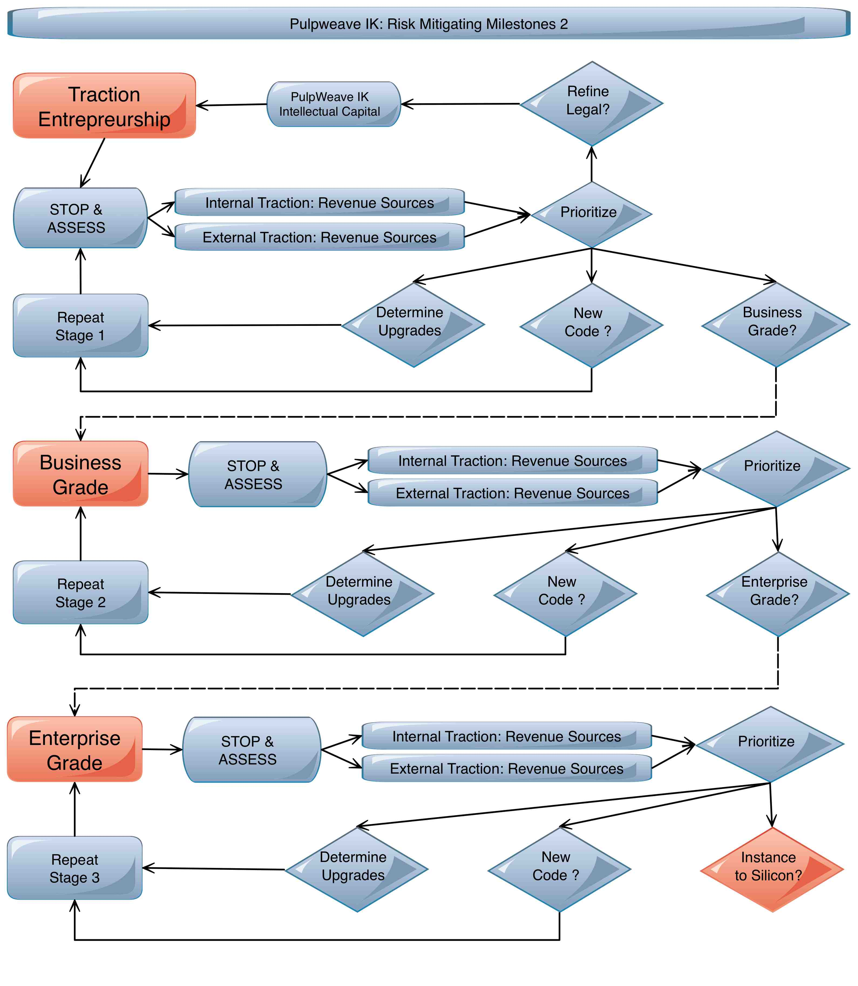
PulpWeave: IK

Slide 44
PulpWeave: IK
This is just a very simplified over of the PulpWeave Intellectual Capital Digital Domain.
More information can be found at www.pulpweave.com
Specifically:
Whitepaper : In depth discussion of IK/Legal and business integration
Executive Summary: Quick written overview
Risk Mitigating Milestones: a more in depth plan
For more in depth discussion please contact:
Marco Fuxa
marco@pulpweave.com
Cel 917 375 1842
Tel 646 687 7926

Slide 45
PulpWeave: IK

